Slide 1
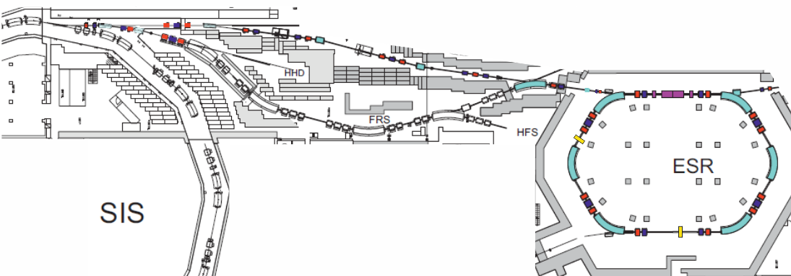
Steps in ESR Setup
Be 1cm
target
⁷⁸Kr
slits
⁷²Ge
inject ⁷⁸Kr into ESR at γ ~ γ_{t}
measure γ_{t} with electron cooler (isochronicity curve)
inject ⁷⁸Kr through target, measure target thickness
set ESR to Bρ of isochronous ⁷²Ge, optimize injection
new E_{SIS} for ⁷²Ge at same Bρ after target
Check resolution with frequency lines of same A/Z = 2.25
ESR fine tuning, cut Bρ distribution with scrapers

Slide 2
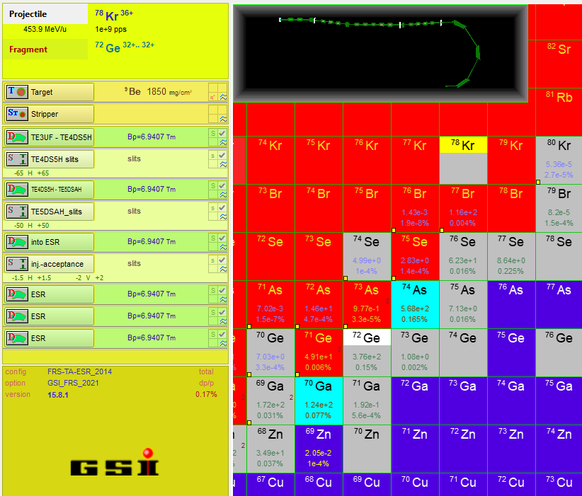
Setting Details
γ_{t} = 1.41, E/m = 381.9 MeV/u => Bρ_{ESR} (⁷²Ge) = 6.9401 Tm
Target 1850 mg/cm² Be => E_{SIS} = 453.9 MeV/u
LISE file of beamline
and ESR acceptance
Low transmission (~ 0.2 %)
only 380 ⁷²Ge / 10⁹ Kr
Expected fragments
in order of intensity:
⁷⁴As, ⁷²Ge, ⁶⁹Ga, ⁶⁷Zn, ⁷⁶Se, ⁷⁰Ga, ⁷⁷Br, ⁶⁵Cu, ⁶²Ni, ⁶⁰Co, .. , ⁶⁸Zn, …

Slide 3
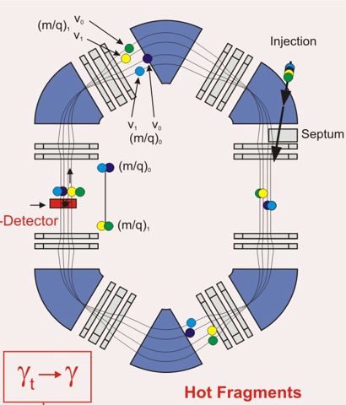
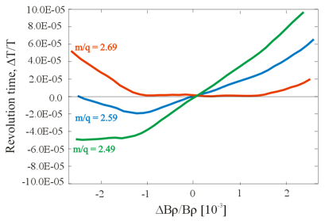
ESR Isochronous Mode
γ_{t} is not constant depends on orbit in ESR
„Cooler curve“ as test of isochronicity
Scan beam Bρ with electron cooler
= df/f
ΔBρ/Bρ [10⁻³]
transform by calculation to other m/q or γ

